Slide 1
MASS STORAGE, SCHEDULING, AND REDUNDANCY
CS 3100 – Chapter 10

Slide 2
Overview of Mass Storage Structure
Magnetic disks provide bulk of secondary storage of modern computers
  Drives rotate at 60 to 250 times per second
  Transfer rate is rate at which data flow between drive and computer
  Positioning time (random-access time) is time to move disk arm to desired cylinder (seek time) and time for desired sector to rotate under the disk head (rotational latency)
  Head crash results from disk head making contact with the disk surface
    That’s bad
Disks can be removable
Drive attached to computer via I/O bus
  Busses vary, including EIDE, ATA, SATA, USB, Fibre Channel, SCSI, SAS, Firewire
  Host controller in computer uses bus to talk to disk controller built into drive or storage array

Slide 3

Moving-head Disk Mechanism

Slide 4
Solid-State Disks
Nonvolatile memory used like a hard drive
  Many technology variations
Can be more reliable than HDDs
More expensive per MB
Maybe have shorter life span
Less capacity
But much faster
Busses can be too slow -> connect directly to PCI for example
No moving parts, so no seek time or rotational latency

Slide 5
Disk Structure
Disk drives are addressed as large 1-dimensional arrays of logical blocks, where the logical block is the smallest unit of transfer
  Low-level formatting creates logical blocks on physical media
The 1-dimensional array of logical blocks is mapped into the sectors of the disk sequentially
  Sector 0 is the first sector of the first track on the outermost cylinder
  Mapping proceeds in order through that track, then the rest of the tracks in that cylinder, and then through the rest of the cylinders from outermost to innermost
  Logical to physical address should be easy
    Except for bad sectors
    Non-constant # of sectors per track via constant angular velocity

Slide 6
Disk Scheduling
The operating system is responsible for using hardware efficiently — for disk drives, this means having a fast access time and disk bandwidth.
Access time has two major components
  Seek time is the time for the disk arm to move the heads to the cylinder containing the desired sector. Seek time ≈ seek distance.
  Rotational latency (delay) is the additional time waiting for the disk to rotate the desired sector to the disk head.
OS Scheduling Goal: Minimize seek time.
The IO Controller handles latency issues.

Slide 7
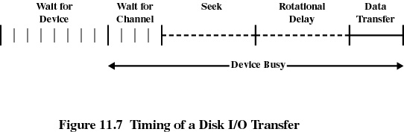
Disk Scheduling (cont)
Disk bandwidth is the total number of bytes transferred, divided by the total time between the first request for service and the completion of the last transfer.

Slide 8
Disk Scheduling (cont)
Several algorithms exist to schedule the servicing of disk I/O requests.
We illustrate them with a request queue (0-199).
98, 183, 37, 122, 14, 124, 65, 67
Head pointer is currently at 53 (Moving Upward)

Slide 9
FCFS
Simplest form of scheduling is first come, first served.
The algorithm is fair.
It is not generally a fast algorithm.

Slide 10

FCFS (cont)
Illustration shows total head movement of 640 cylinders.

Slide 11
SSTF
Shortest seek time first (SSTF).
Selects the request with the minimum seek time from the current head position.
SSTF scheduling is a form of SJF scheduling; may cause starvation of some requests.
Illustration shows total head movement of 208 cylinders.

Slide 12

SSTF (cont)

Slide 13
SCAN
The disk arm starts at one end of the disk, and moves toward the other end, servicing requests until it gets to the other end of the disk, where the head movement is reversed and servicing continues.
Sometimes called the elevator algorithm.
Illustration shows total head movement of 236 cylinders.
Note: head is starting in the downward position in this example….

Slide 14
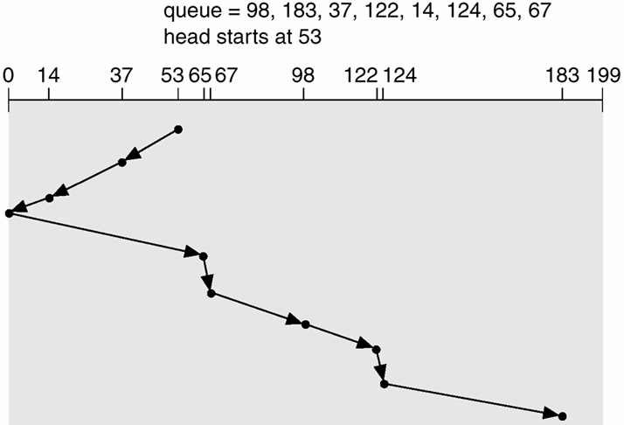
SCAN (cont)

Slide 15
C-SCAN
Circular SCAN (C-SCAN) provides a more uniform wait time than SCAN.
The head moves from one end of the disk to the other, servicing requests as it goes. When it reaches the other end, however, it immediately returns to the beginning of the disk, without servicing any requests on the return trip.
Treats the cylinders as a circular list that wraps around from the last cylinder to the first one. 183 Movements (Return not counted).

Slide 16

C-SCAN (cont)
NOT COUNTED!

Slide 17
C-LOOK
Version of C-SCAN
Arm only goes as far as the last request in each direction, then reverses direction immediately, without first going all the way to the end of the disk.
153 Movements (Floor, Ceiling, and Return Not Counted).

Slide 18

C-LOOK (cont)
NOT COUNTED!
NOT COUNTED!
NOT COUNTED!

Slide 19
Selecting a Disk Scheduling Algorithm
SSTF is common and has a natural appeal
SCAN and C-SCAN perform better for systems that place a heavy load on the disk.
Performance depends on the number and types of requests.
Requests for disk service can be influenced by the file allocation method.

Slide 20
Selecting a Disk Scheduling Algorithm (cont)
The disk scheduling algorithm should be written as a separate module of the operating system, allowing it to be replaced with a different algorithm if necessary.
Either SSTF or LOOK is a reasonable choice for the default algorithm.

Slide 21
Disk Reliability
Several improvements in disk-use techniques involve the use of multiple disks working cooperatively.
Disk striping uses a group of disks as one storage unit.
RAID schemes improve performance and improve the reliability of the storage system by storing redundant data.
  Mirroring or shadowing keeps duplicate of each disk.
  Block interleaved parity uses much less redundancy.

Slide 22
RAID
Raid: Redundant Array of Independent Disks
Similar to Multi-Processing on a CPU
Raid is a set of physical disk drives viewed by the OS as a single logical drive.
Data are distributed across all the drives.
Parity information is also stored, which guarantees data recoverability in case of disk failure.

Slide 23
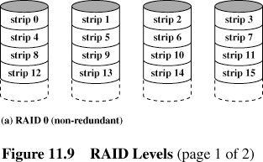
RAID 0 (non-redundant)

Slide 24
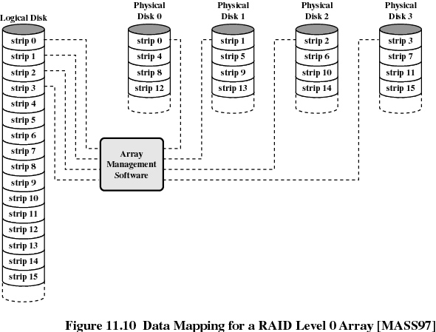

Slide 25
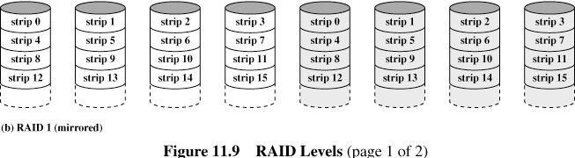
RAID 1 (mirrored)
An exact copy (or mirror) of a set of data on two or more disks.

Slide 26
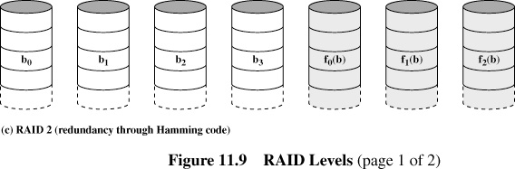
RAID 2 (redundancy through Hamming code)
The disks are synchronized by the controller to spin at the same angular orientation (they reach Index at the same time).
Extremely high data transfer rates are possible.
This is the only original level of RAID that is not currently used.

Slide 27
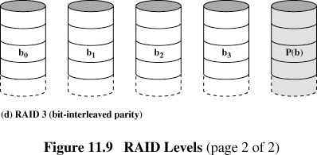
RAID 3 (bit-interleaved parity)
RAID 3 is very rare in practice. One of the characteristics of RAID 3 is that it generally cannot service multiple requests simultaneously. This happens because any single block of data will, by definition, be spread across all members of the set and will reside in the same location. So, any I/O operation requires activity on every disk and usually requires synchronized spindles.

Slide 28
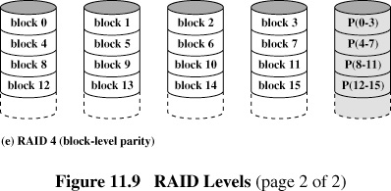
RAID 4 (block-level parity)
Uncommon. This allows each member of the set to act independently when only a single block is requested. If the disk controller allows it, a RAID 4 set can service multiple read requests simultaneously.

Slide 29
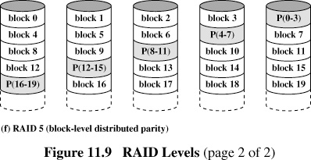
RAID 5 (block-level distributed parity)
RAID 5 has achieved the most popularity and use because of its low cost of redundancy.

Slide 30
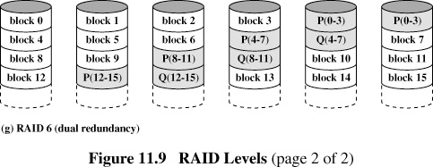
RAID 6 (dual redundancy)
RAID 6 does not have a performance penalty for read operations, but it does have a performance penalty on write operations because of the overhead associated with parity calculations.
Performance varies greatly depending on how RAID 6 is implemented in the manufacturer's storage architecture

Slide 31

RAID (0 + 1) and (1 + 0)

